Slide 1
Team Leader
Lobby Day Briefing
Summit 2023

Slide 2
Today's Agenda
NBCC Top Legislative Priorities
Lobby Day Strategy Prep
Key Responsibilities During Summit/Lobby Day
Attendee App Review
Communicating During Lobby Day

Slide 3
2023 Legislative and Public Priorities
Legislative Priorities
$150 Million/Level Funding for the Department of Defense (DOD) Breast Cancer Research Program (BCRP) for FY2024
Metastatic Breast Cancer Access to Care Act (H.R. 549)
Preservation of the Medicaid Breast and Cervical Cancer Treatment Program
Public Policy Priorities
Guaranteed Access to Quality Health Care for All
Access to Affordable and Effective Therapies
Federal Drug Administration Reform
Ensuring the Participation of Educated Patient Advocates in Science Research and All Levels of Health Care Decision Making.

Slide 4
Key Updates
Metastatic Breast Cancer Access to Care Act
HR 549 (Garbarino, Castor)
117 cosponsors so far (92 D, 25 R)
S 663 (Murphy, Ernst)
2 additional cosponsors so far (1R, 1D)
DOD BCRP – FY24 Appropriations Update
160 House signers
32 Senate signers

Slide 5
Key Asks: DOD (available in talking points & the attendee app)
$150 million "("robust funding) for the Department of Defense (DOD) Peer-Reviewed Breast Cancer Research Program (BCRP) for Fiscal Year 2024.
HOUSE
(1) For House Members who signed the letter in support of funding for the DOD Peer Reviewed BCRP for FY2024: Thank you for signing the letter supporting funding for the DOD BCRP. Will you please continue to encourage your colleagues to support this important program as it moves through the appropriations process? Will you let us know if you hear of any issues that may arise with this request? i.e. threats to the program, report language etc. Is there anyone we should be talking with to ensure the passage of this request?
(2) For House Members who did not sign the letter: The appropriations process is ongoing, please support the DOD BCRP funding request as it moves through the process.
SENATE
(1) For Senators who signed the letter in support of funding for the DOD peer-reviewed BCRP for FY2024: Thank you for signing the letter supporting funding for the DOD peer-reviewed BCRP. Please encourage your colleagues to support the funding request as it moves through the appropriations process. Will you let us know if you hear of any threats to the program or requests for report language? Who else should we be talking with to ensure the passage of this funding request?
(2) For Senators who did not sign the letter: The appropriations process is ongoing; please support the DOD BCRP funding request and urge your colleague to do the same as it moves through the process.

Slide 6
Key Asks: MBCACA
Enact the Metastatic Breast Cancer Access to Care Act (S. 663 (Murphy (D-Ct/Ernst (R-IA)/HR 549 (Garbarino (R-NY)/Castor (DFL)
HOUSE/ SENATE
For Members who have cosponsored the Metastatic Breast Cancer Access to Care Act: Thank you for cosponsoring this legislation. Is there something you can do to help us get additional Members of Congress to sign on? Some examples include getting others from your state delegation to cosponsor, getting others on your Committee to cosponsor, and/or getting support from Members of a Congressional Caucus to which you belong. What do you think is the best way for us to pass this legislation in this Congress? How can you help us get the bill passed?
For Members who have not cosponsored the Metastatic Breast Cancer Access to Care Act: Will you cosponsor S. 663/HR 549, the Metastatic Breast Cancer Access to Care Act? If not, why not? Is there additional information we could provide you to get your support?

Slide 7
FDA Reform
We all want to save lives and end breast cancer. We are looking at FDA and the drug approval process. We are concerned about drugs that do not benefit patients and also about the high cost of breast cancer treatment. We want to get behind a system that approves drugs that significantly extend life and quality of life, as quickly as possible. We hope to work with you to help make that happen.

Slide 8
Facts and Figures
In 2023, there will be an estimated 297,790 new cases of invasive breast cancer diagnosed in women; 2,800 new cases diagnosed in men, and an additional 55,720 new cases of ductal carcinoma in situ (DCIS) diagnosis in women.
In the United States, a woman’s lifetime risk of being diagnosed with invasive breast cancer has increased since 1975.
2017-2019: 1 in 8 (12.9%)
1975-1977: 1 in 11 (9.1%)
Progress in reducing breast cancer mortality has slowed in recent years, from 2% to 3% annually during the 1990s and 2000s to 1% annually from 2011 to 2020.

Slide 9
Key Responsibilities at Summit
Keep confirming meetings via the Google doc
Lead Your State Delegation Meeting (Monday, 4:45 PM)
Locations in the Conference App
See Maggie at Lobby Day Table for meeting changes/questions/help
Go over Lobby Day schedule
Ensure advocates know which meetings they are attending
Overview how meetings will run
If time: roleplay using the State Delegation Guide
Attend Lobby Day Briefing & Ensure your Delegation Attends (Monday, 3pm)

Slide 10
Key Resources for you
Full version: talking points
Tough Questions
In-app custom talking points per meeting
Congressional-District specific One-pager *
Template press release

Slide 11
Lobby Day Tools
We are using the same app as last year; all attendees will receive an invitation shortly.
All confirmed meetings have been added to the Lobby Day attendee app, which is linked to throughout the conference app and our flyers: nbcc.info/LobbyDayAttendees
All talking points, backgrounders & resources are available in the conference app and on the Team Leader Resource Page

Slide 12
Lobby Day attendee app- enter your email

Slide 13
Your schedule, attendees, talking points

Slide 14
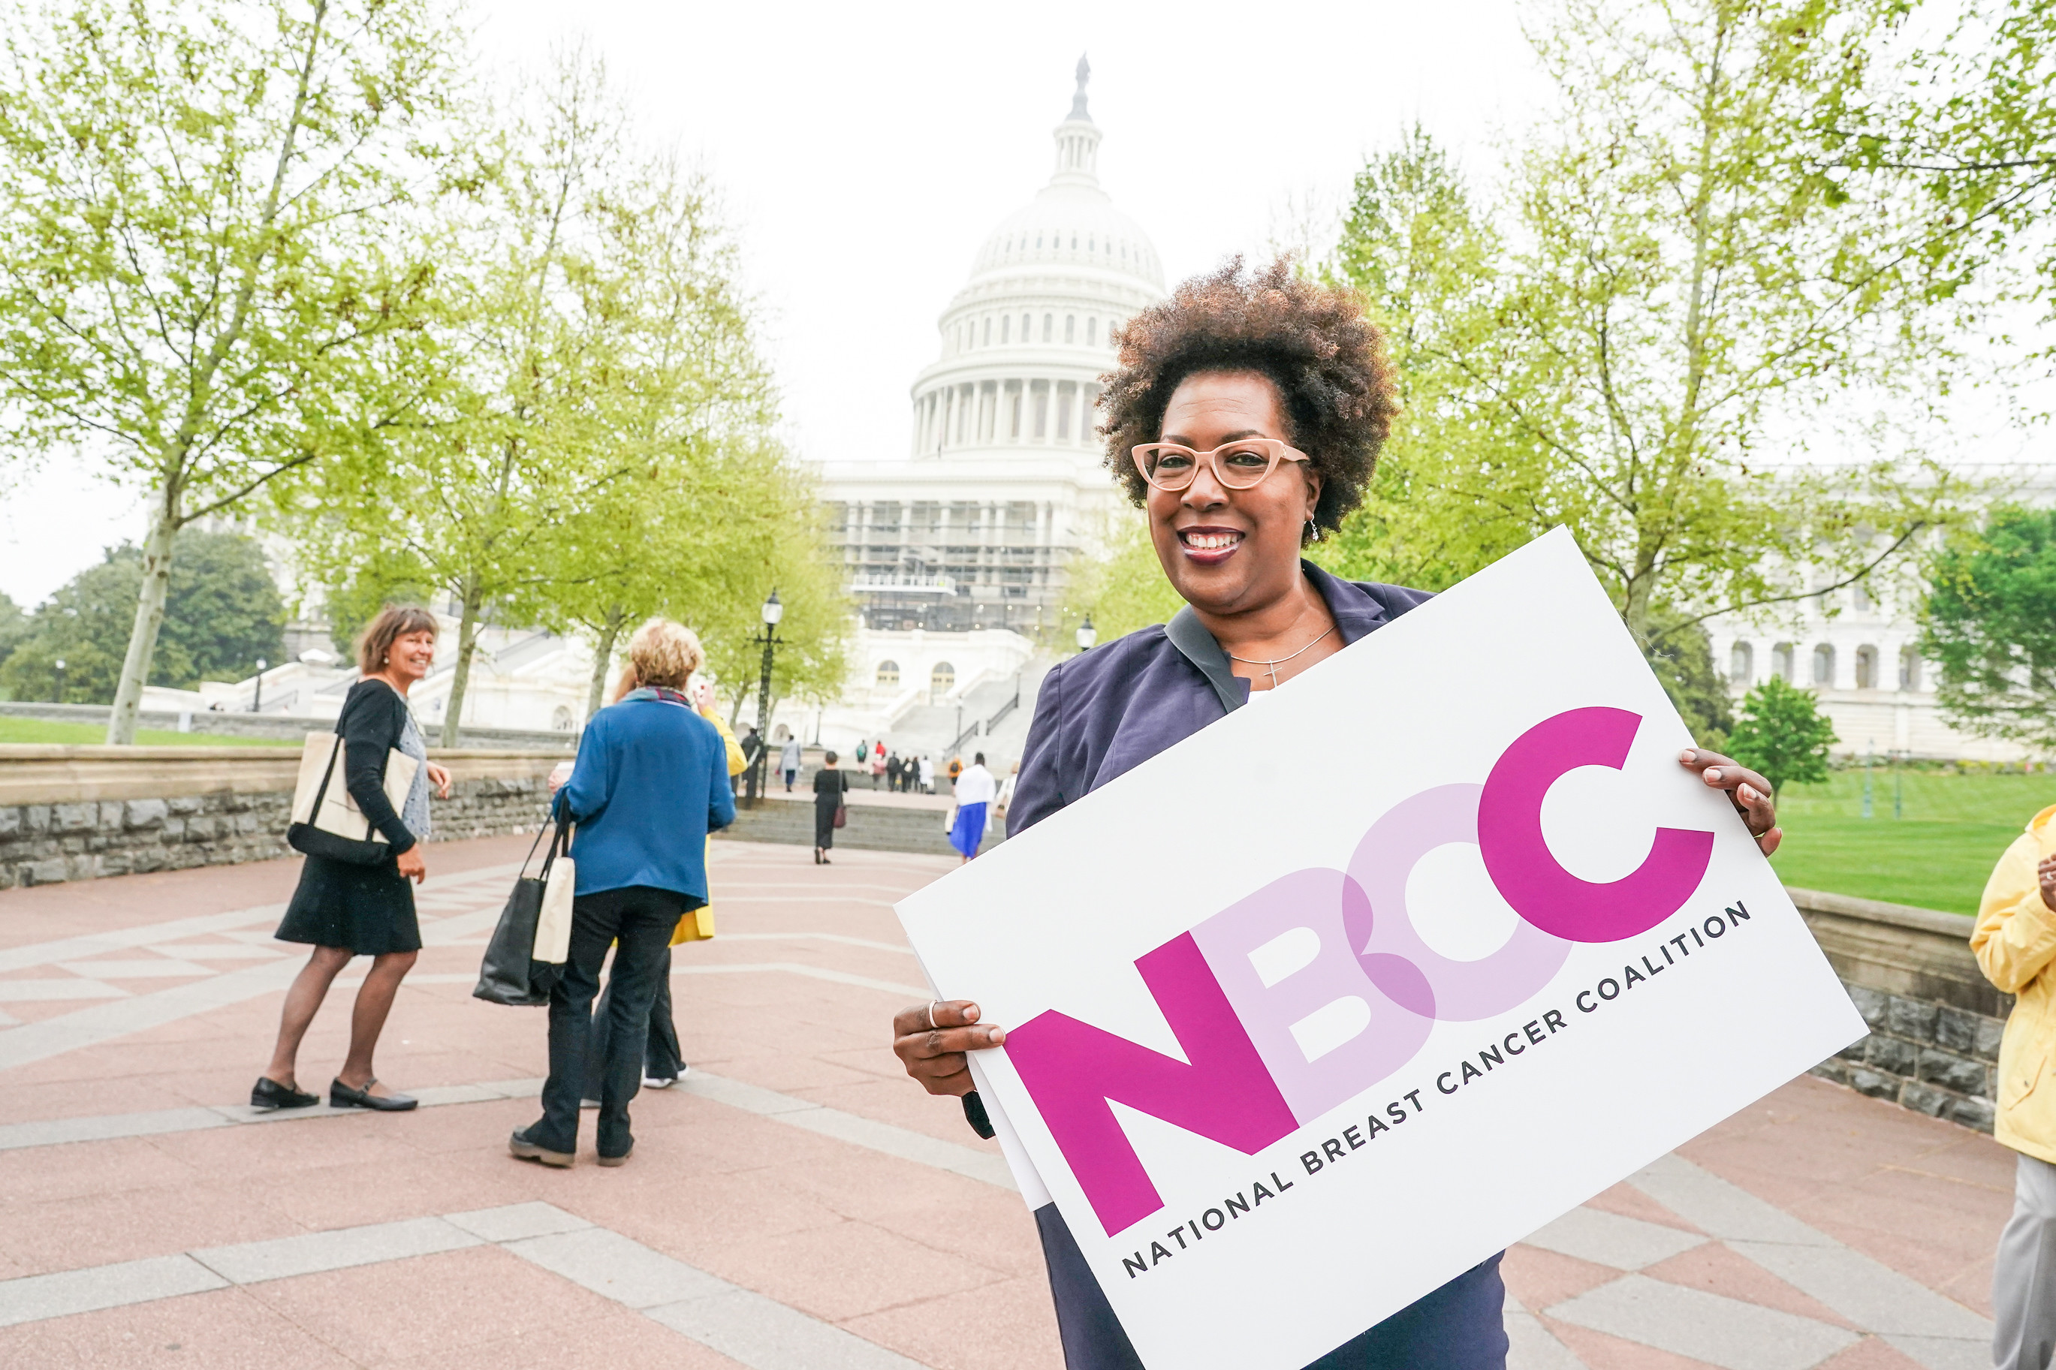
Communicating During
Lobby Day
Staff will be on-site at the ROA building all day
Luggage drop-off, food, WiFi until 6pm
Group picture immediately upon arriving on buses
We will celebrate progress all day long at the ROA!
Maggie will send out text alerts to team leaders throughout the day
Respond to Maggie with:
Commitments made by Reps/staff in your meetings
Great things said about NBCC advocates
Pictures you take
Immediately post Lobby Day: fill out your reports for every meeting attended.

Slide 15
Questions?

