Slide 1
FDA Draft Guidance on Study Designs to Support Accelerated Approvals
&
USPSTF Draft Breast Cancer Screening Recommendations
NBCC Public Comments
Team Leaders

Slide 2
FDA Draft Guidance for Sponsors on Accelerated Approval
March 24 – FDA released draft guidance for trial sponsors
Docket No. FDA-2023-D-0110 for "Clinical Trial Considerations to Support Accelerated Approval of Oncology Therapeutics
60 days for public comments
Due by May 26

Slide 3
Background on the Guidance
Purpose: To encourage study designs for clinical trials that will improve the data available at the time of accelerated approval and reduce clinical uncertainty for patients by initiating postmarketing confirmatory studies in a timely manner.
To minimize the period of uncertainty for patients.

Slide 4
Background on the Guidance
Outlined 3 study designs and specific considerations for each
The traditional, 2-RCT approach (one using a surrogate endpoint for AA and a second confirmatory trial with a clinical endpoint)
Single RCT for both AA and regular approval (New)
Single-arm trial

Slide 5
Background on the Guidance
The traditional, 2-RCT approach (one using a surrogate endpoint for AA and a second confirmatory trial with a clinical endpoint)
The confirmatory trial should have already started and be close to or have completed patient accrual.
Alternatively, the confirmatory trial can be in an earlier disease setting

Slide 6
Background on the Guidance
Single RCT approach
Preliminary surrogate endpoint for AA; and longer-term secondary clinical endpoint for conversion to regular approval
Endpoints for this approach are critical
Other design considerations discussed included:
If crossover will be permitted
Control arm treatment
Combination regimens – the need to be able to demonstrate the impact for each component of the regimen independently
Plan for dealing with multiple endpoints and the potential for a false positive type-1 error (alpha splitting and hierarchical statistical plans)
Trial size with enough power

Slide 7
Background on the Guidance
Single-arm trial considerations
Endpoints like response rate
Magnitude of response and the duration of response
Blinded independent central review
Available therapies and plans for comparing data to other therapies on the market for the condition
Pre-specifying the historical control
Sample size of the trial

Slide 8
NBCC Comment
Primary concern: FDA continues to include progression-free survival (PFS) as a “clinical endpoint”
NOT a measure of how a patient feels, functions, or survives.

Slide 9
NBCC Comment
Primary concern: FDA continues to include progression-free survival (PFS) as a “clinical endpoint”
PFS represents the time from randomization or the initiation of treatment to measurable (typically by radiographic measurement in solid tumors) disease progression or death.
Progression is defined by the Response Evaluation Criteria in Solid Tumors as an increase in the sum of maximum tumor diameters of at least 20%, the development of any new lesions, or an unequivocal increase in non-measurable malignant disease.
Originally developed to support the advancement of drugs in Phase 2 clinical trials to Phase 3 testing
Subject to various forms of bias

Slide 10
NBCC Comment
Other concerns we listed:
Power of the trial to answer clinically-meaningful endpoint (like overall survival)
FDA should provide strong language about ensuring trial sample is large enough to assess benefit of clinical endpoint
Educated advocate involvement
FDA should recommend the inclusion of educated patient advocates/advocacy organizations in trial design and implementation

Slide 11
USPSTF Breast Cancer Screening
Draft Recommendations
Released on May 9, 2023
30 days for public comment
Due on June 5, 2023

Slide 12
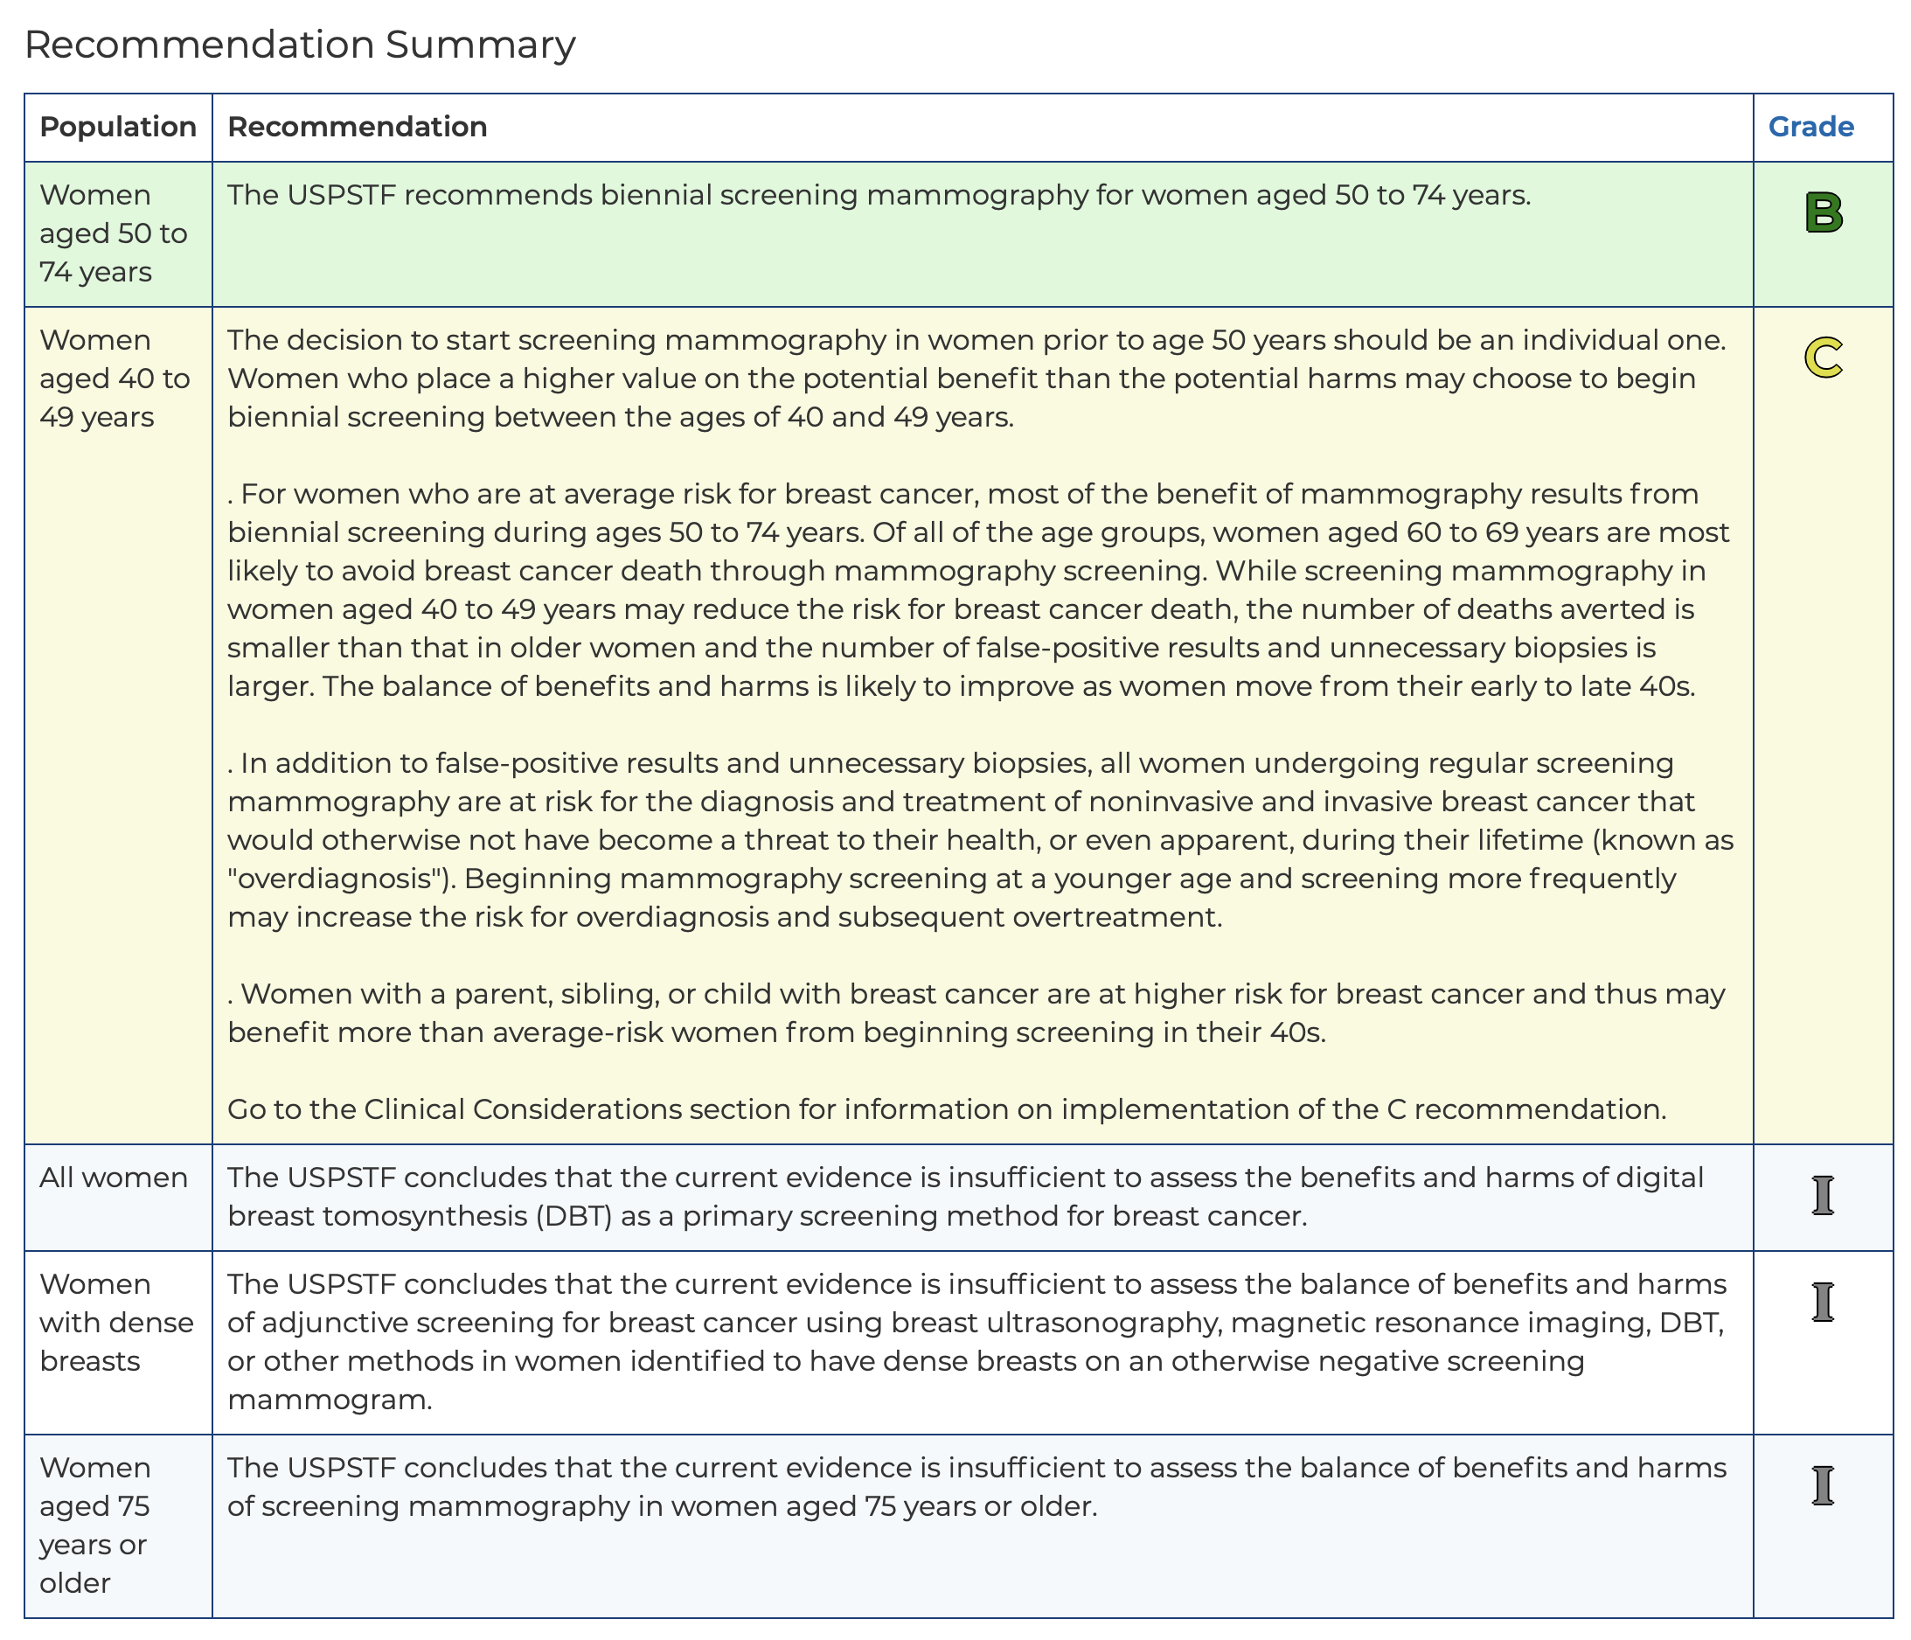
CURRENT USPSTF Recommendations
https://www.uspreventiveservicestaskforce.org/uspstf/recommendation/breast-cancer-screening#fullrecommendationstart

Slide 13
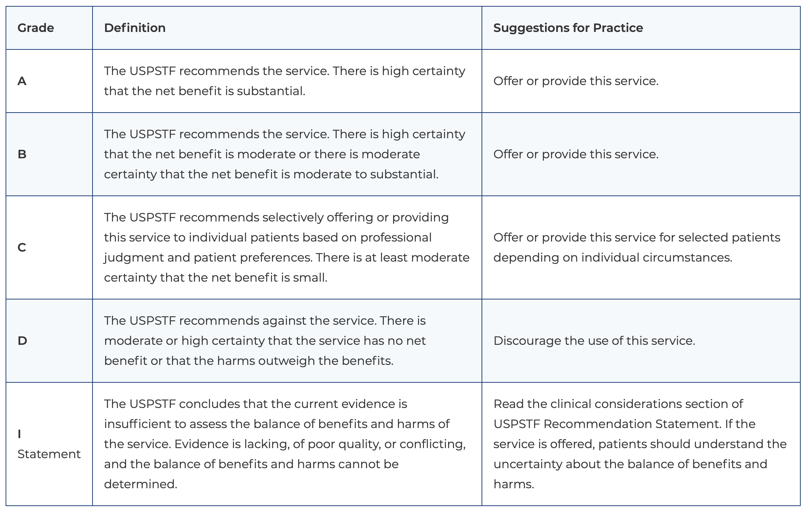
Definitions of USPSTF Grades
https://www.uspreventiveservicestaskforce.org/uspstf/about-uspstf/methods-and-processes/grade-definitions

Slide 14
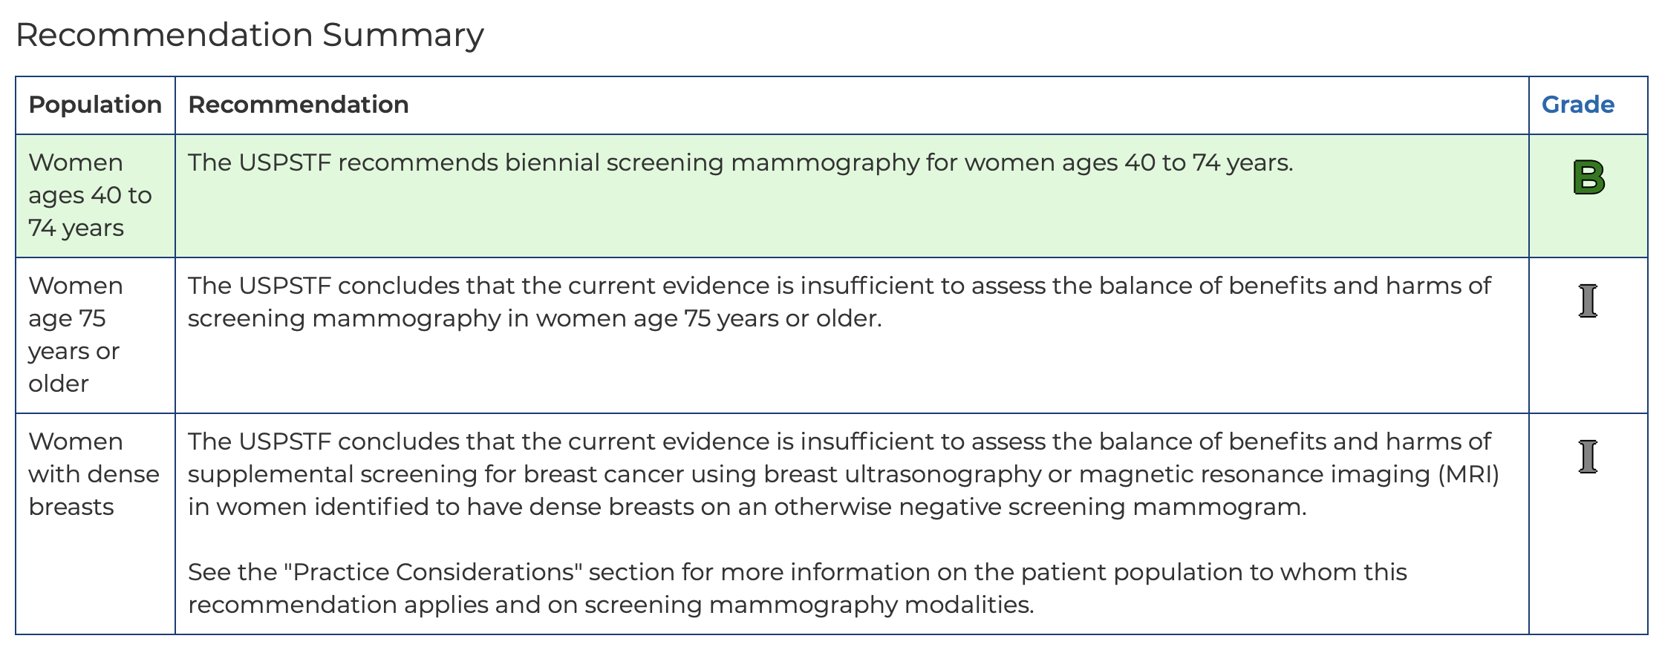
**DRAFT** USPSTF Recommendations
(as of June 20, 2023)
https://www.uspreventiveservicestaskforce.org/uspstf/draft-recommendation/breast-cancer-screening-adults

Slide 15
What Has Changed?
No new empirical data
Used the Cancer Intervention and Surveillance Modeling Network (CISNET models) with modified input data
Breast cancer natural history, breast cancer treatment benefit, breast cancer incidence, screening benefit from RCTs, stage distribution among diagnosed cancers, ER/HER2 subtype distribution, etc.
Increased incidence of breast cancer among 40-49 year olds (~2% annually between 2015-2019)
The six models were independently developed and all replicate breast cancer incidence and mortality in the US female population. The models use common data inputs but each modeling team makes independent assumptions regarding the natural history of breast cancer and how the data inputs are incorporated into the models.
https://www.uspreventiveservicestaskforce.org/uspstf/document/draft-modeling-report/breast-cancer-screening-adults

Slide 16
How Well the Models Predict BC Incidence

Slide 17
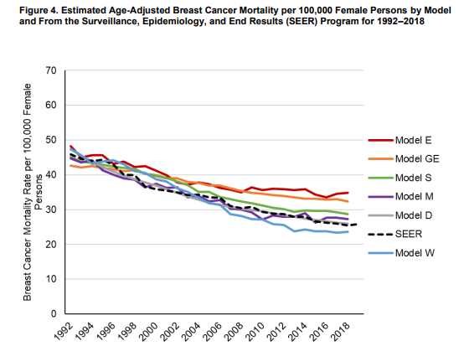
How Well the Models Predict BC Mortality

Slide 18
What They Found From Models (2016)
Each of the six modeling approaches found different estimates for each potential benefit and harm considered.
In 2016 (the last USPSTF update)
Lowering the starting age for screening from 50 years to 40 years would result in 1.0 additional breast cancer death averted (going from 7 to 8 deaths averted) for every 1,000 women screened over a lifetime.
As a result, screening in this age group (40-49 years) was given a “C” level recommendation, making the decision to start screening during this period, an individual one.

Slide 19
What They Found From Models (2023)
In 2023 (current draft USPSTF recommendation)
Lowering the starting age from 50 years to 40 years for biennial mammography would result in 1.3 more breast cancer deaths averted (all women; going from about 7 to 8.3).
Yes, 0.3 more breast cancer deaths averted compared to the 2016 recommendation.
In Black women specifically, the collaborative modeling analysis also found that 1.8 more breast cancer deaths would be averted for every 1,000 Black women screened over a lifetime.
The recommendation change is largely motivated by the large disparities in breast cancer outcomes for Black women.

Slide 20
Estimated Harms of the Age Change
A ~60% increase in false-positive results (going from 873 false-positive results to 1,376)
A ~36% increase in benign biopsies (going from ~148 to 210)
An additional 2 cases of overdiagnosis (going from 12 overdiagnosed cases to 14)
(Note: there was a large amount of variation across the models regarding the impact on overdiagnosis, from as few as 4 cases to as many as 37 overdiagnosed cases.)

Slide 21
Limitations of the Models
ALL of the models assumed 100% screening adherence, prompt evaluation of abnormal screening results, and appropriate and timely access to treatment.
BEST CASE SCENARIO – BUT NOT THE REAL SCENARIO

Slide 22
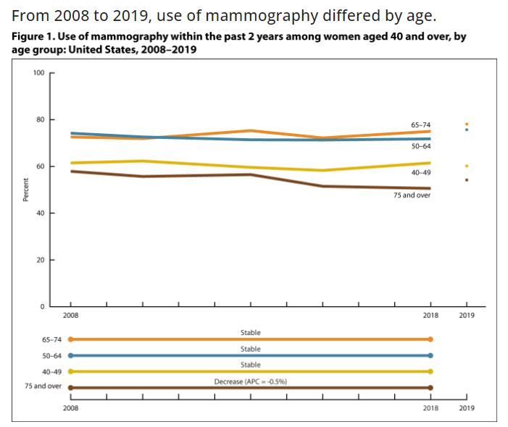
What Screening Is Already Going On in This Age Group?
According to the CDC, ~60% of all women between 40-49 years of age are already being screened.
https://www.cdc.gov/nchs/hus/topics/mammography.htm#featured-charts

Slide 23
What Screening Is Already Going On in This Age Group?
According to the CDC, ~60% of all women between 40-49 years of age are already being screened.
https://www.cdc.gov/nchs/hus/topics/mammography.htm#featured-charts

Slide 24
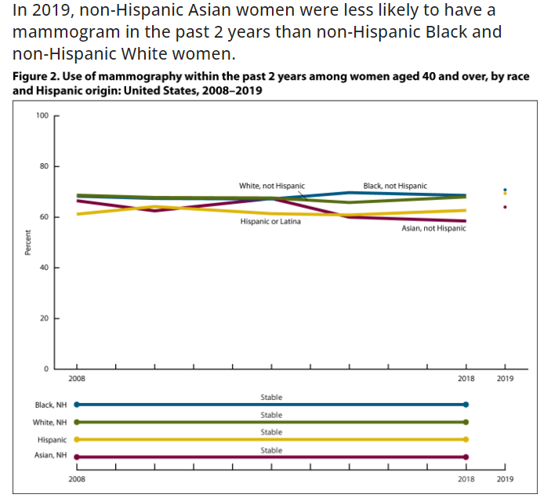
What Screening Is Already Going On in This Age Group?
https://www.cdc.gov/nchs/hus/topics/mammography.htm#featured-charts

Slide 25
NBCC Statement
Screening with mammography will not eliminate the long-standing disparities that exist in breast cancer outcomes regardless of the start and stop age.
They are the result of structural racism, and the health care policies that create inequitable access to appropriate, timely, and quality care.

Slide 26
NBCC Statement
Diverting billions more dollars each year to an ineffective or at best, weakly effective intervention like screening that includes so much harm diverts those resources from addressing the tough questions, like how we prevent breast cancer or stop it from becoming lethal and how to create an equitable health care system.
Mammography screening is not the answer to ending breast cancer and saving lives, and continued emphasis on it as a dominant strategy is misplaced.

